Slide 1
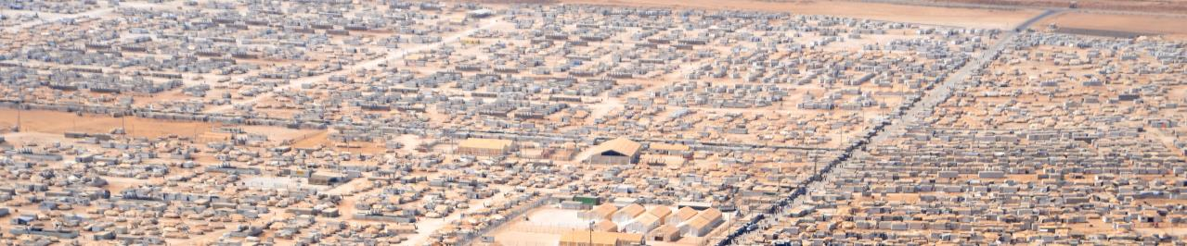
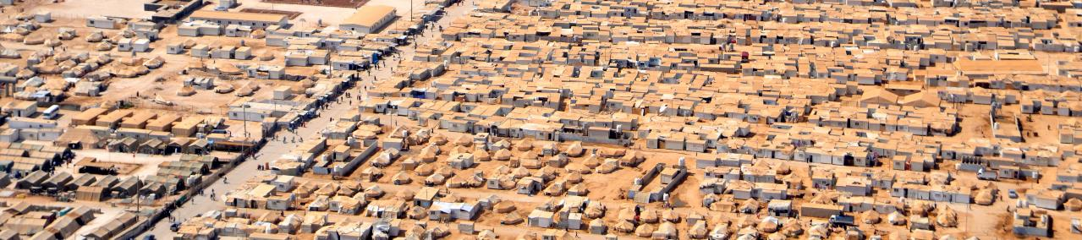
Bazaar - Camp Zataari
Mid term presentation – Group 2

Slide 2





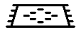
Problem
Original Situation
War
Refugee Camp
Improvised conditions

Slide 3




Problem
Goal
Improvised Conditions
Lost Identity
Unemployment
Theft
Reinstate initial conditions by a Bazaar
?
Problems
?
??

Slide 4
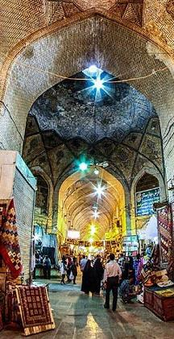
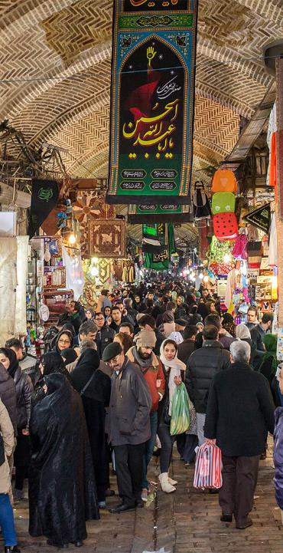
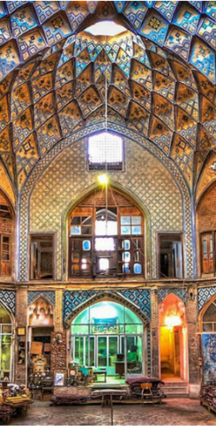

Slide 5
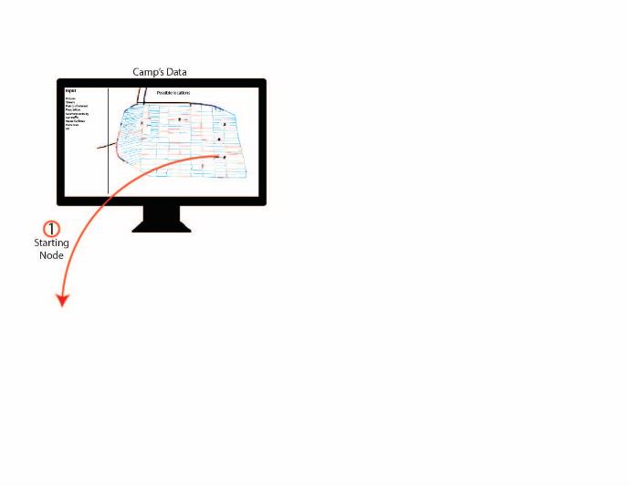
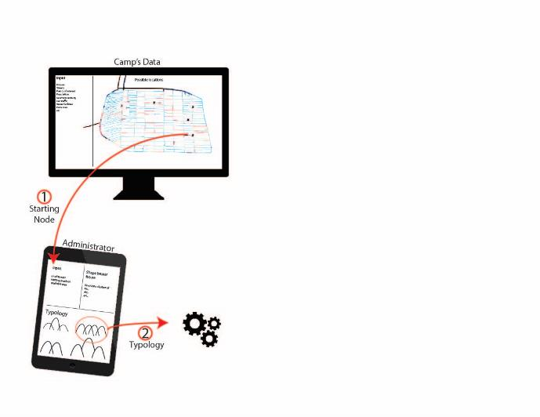
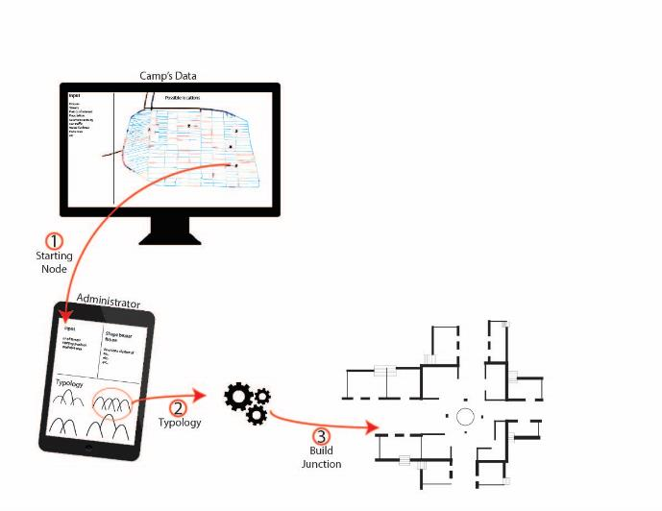
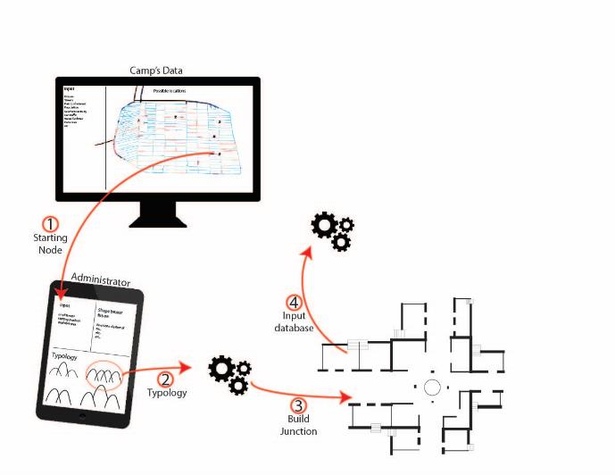
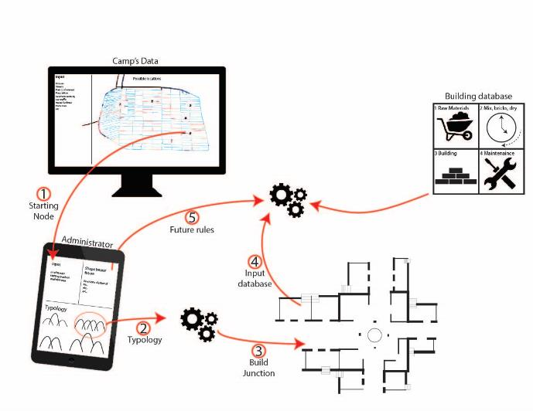
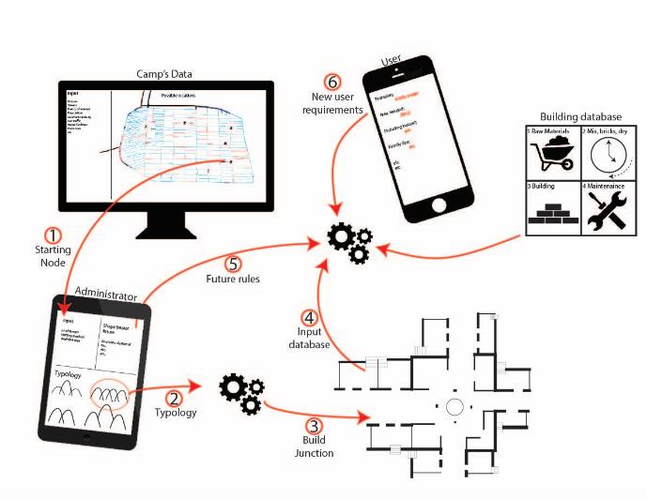
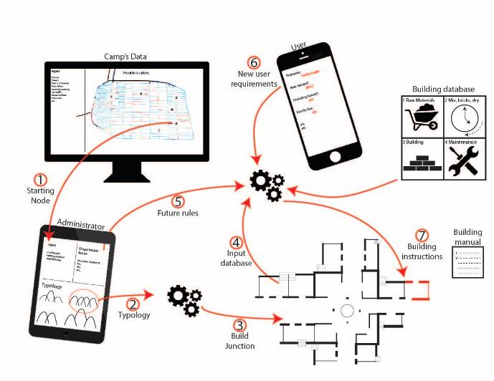
Building vs Computational Method
For all Refugee Camps
Creating a manual
Input from camp and user

Slide 6
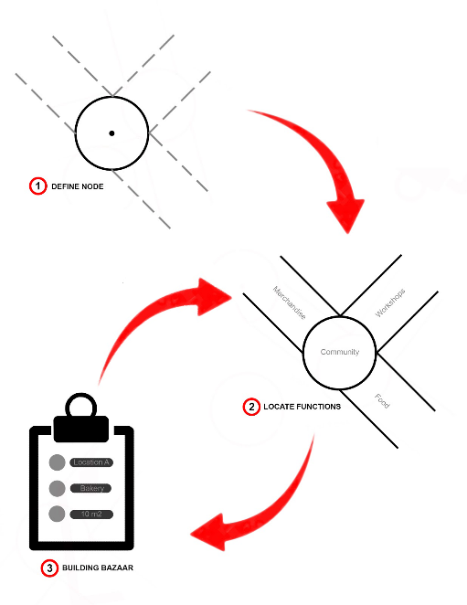
Method
Define a Node
Location of the Function
Building a Bazaar

Slide 7
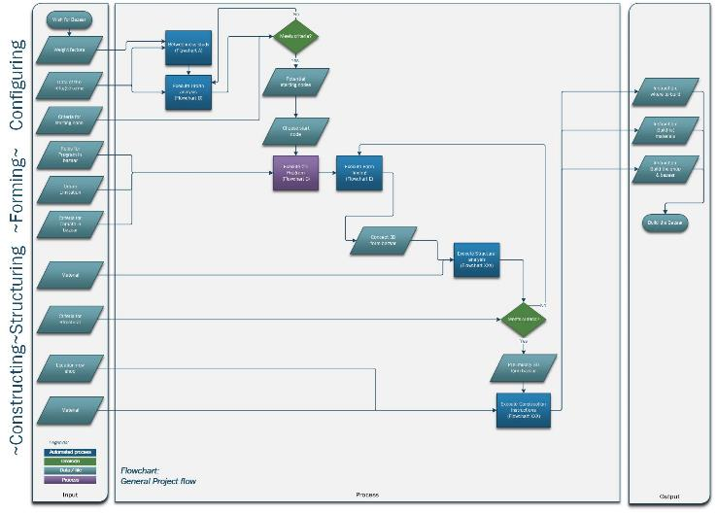
Flowchart – General

Slide 8
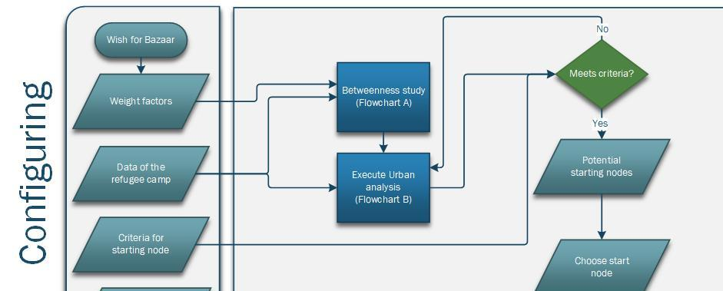
Flowchart – Configuring

Slide 9
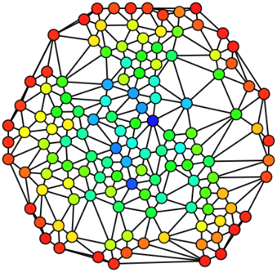
Finding the starting node
‘’In graph theory, betweenness centrality is a measure of centrality in a graph based on shortest paths.’’
Social Security
High crime rate

Slide 10
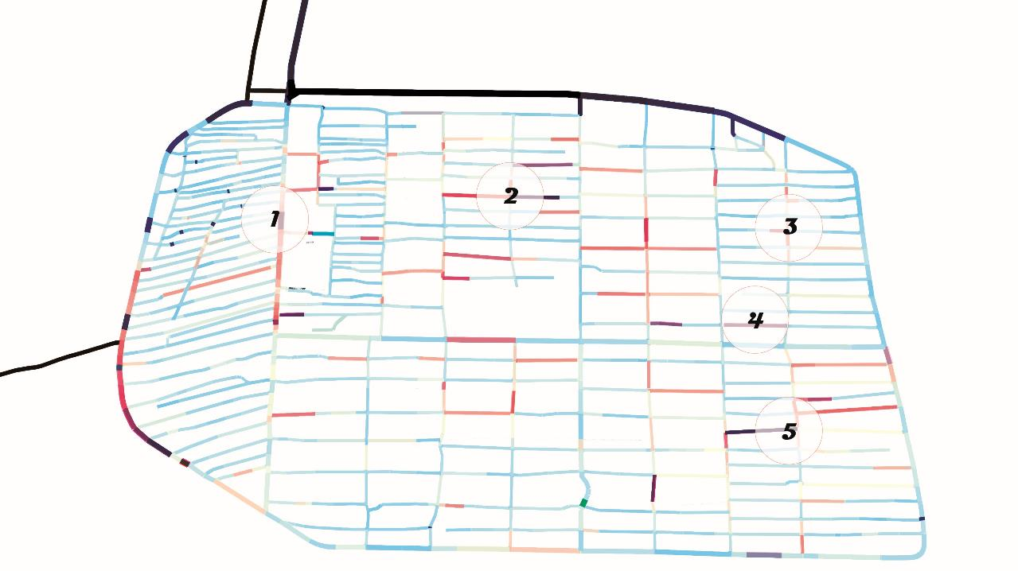
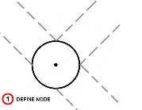
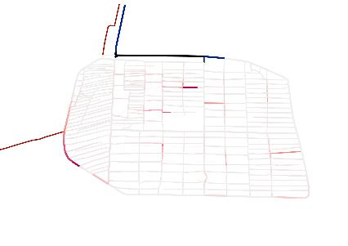
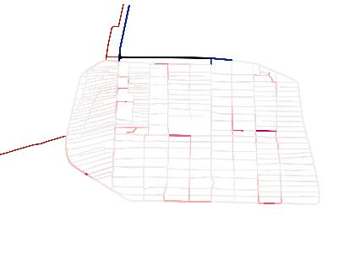
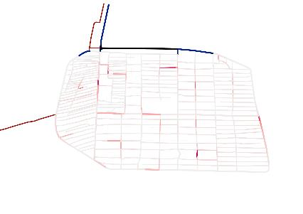
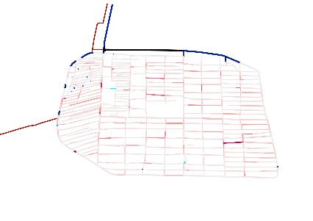
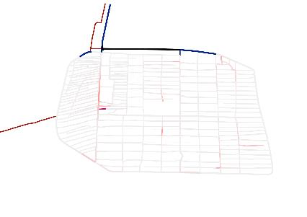
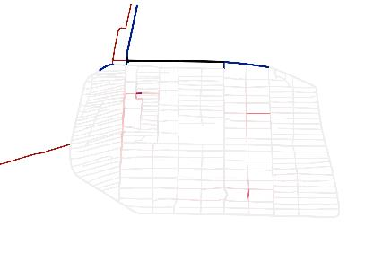
Betweenness Centrality
Rules:
-No cars aloud -Access to water
-Near to a Mosque
-Near a logistical point
-The map
Decided between 2-3-5 Choosen location: 2
-> Near highest density camp
Water facilities
Schools
Community Center
Mosque
Playground
Kindergarten

Slide 11
Method
Define a Node
Location of the Function
Building a Bazaar

Slide 12
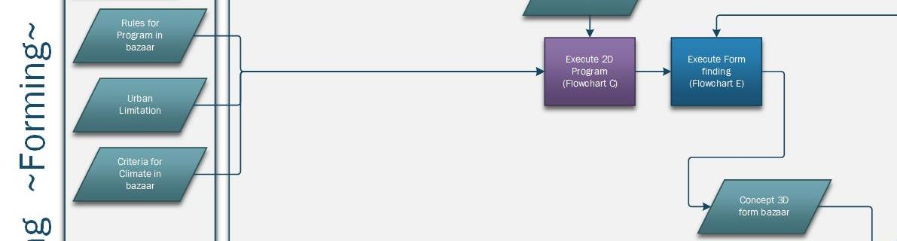
Flowchart – Forming
Choose starting node

Slide 13
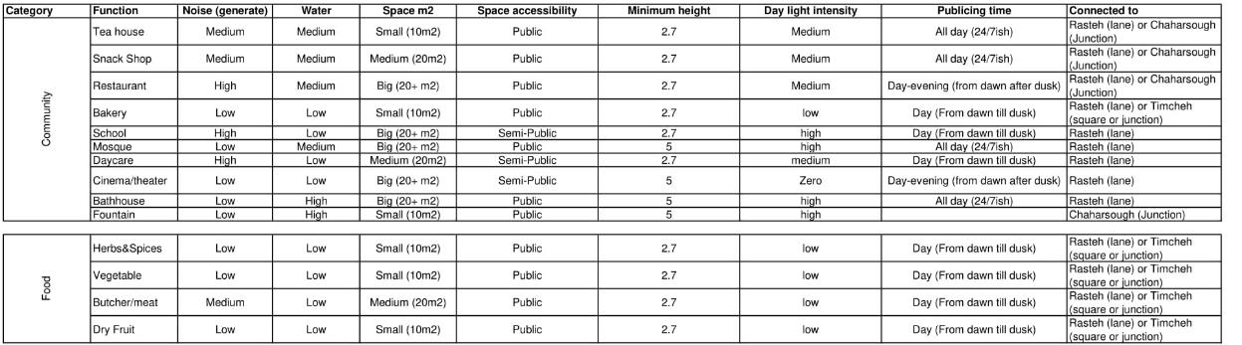
Programme of Requirment

Slide 14
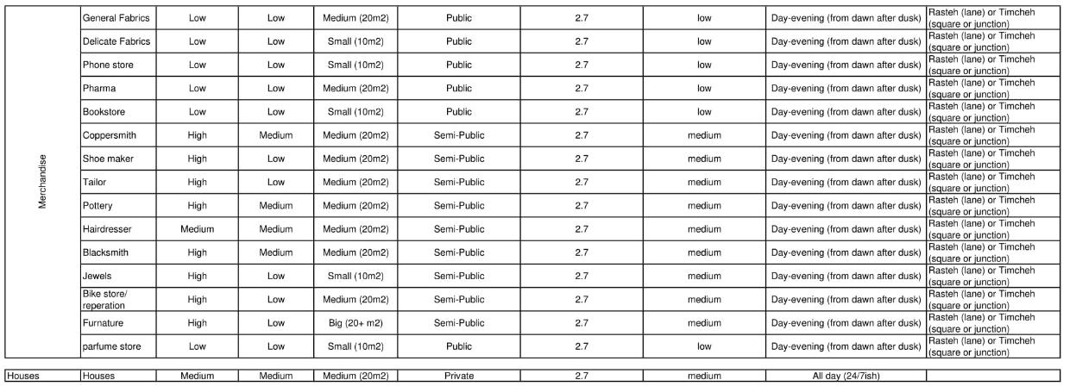
Programme of Requirment

Slide 15
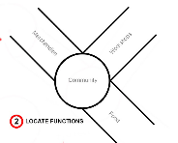
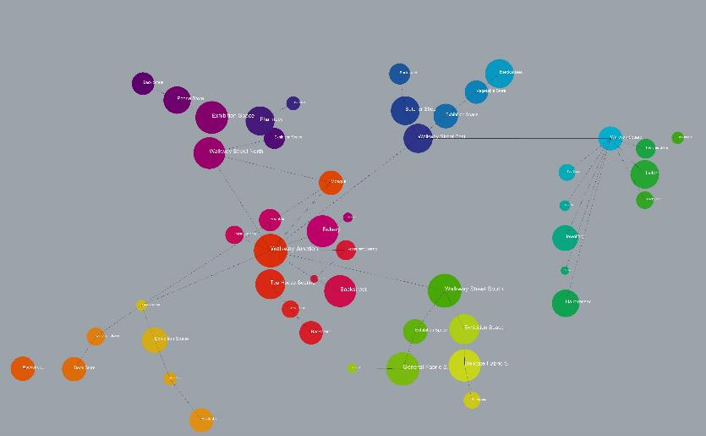
Method - Manual
Street
Street
Square
Street
Junction
Street

Slide 16
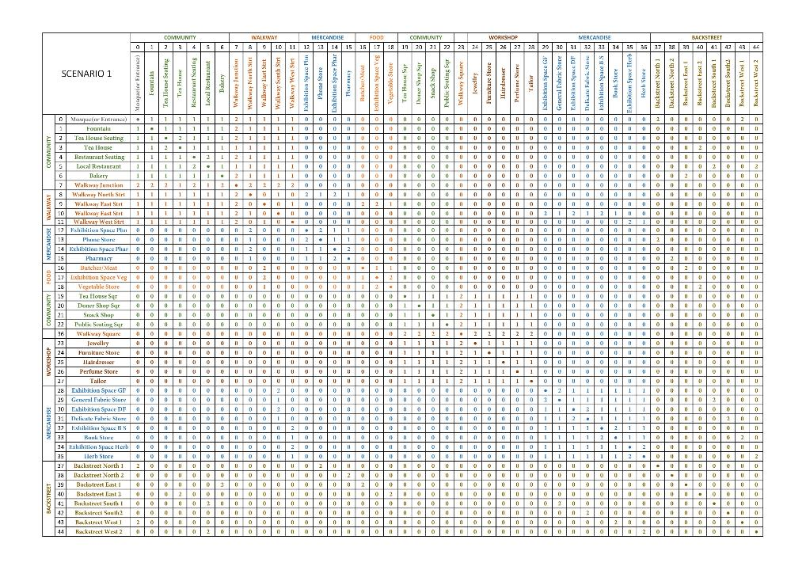
REL Chart

Slide 17
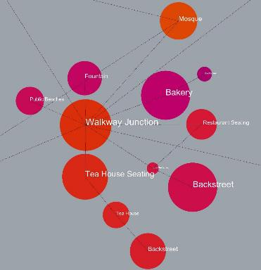
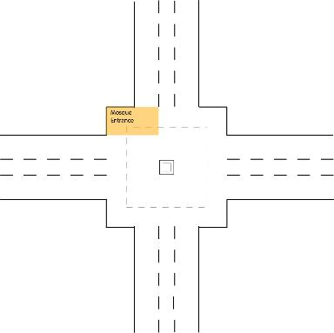
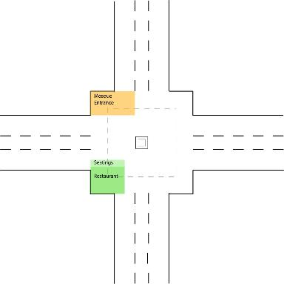
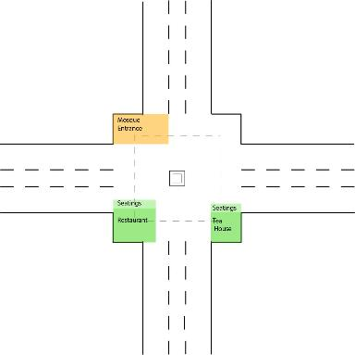
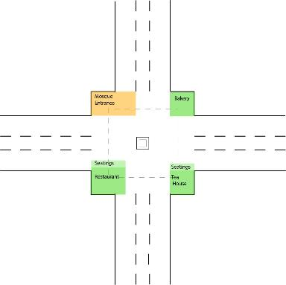
Method – Manual (Example)
-Vahid want to have a local restaurant.
A restaurant is a Community shop
-Ashkan want to have a Tea House.
A Tea House is a Community shop
Rule: Community shops should be placed around the junction or square
Rule: The -seating’s should be connected to – and facing a street, junction or square

Slide 18
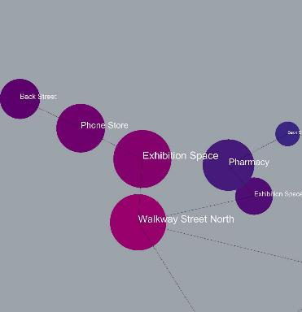
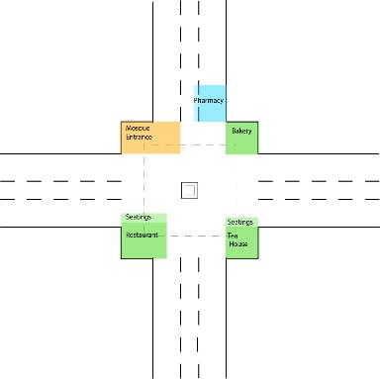
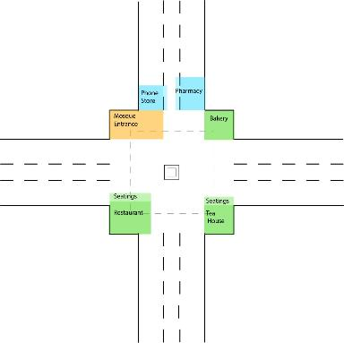
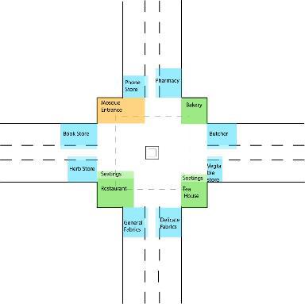
Method – Manual (Example)
-Javad want to have a Phone store.
A Phone is a Merchandise store.
-Khalid want to have a Pharmacy.
A Pharmacy is a Merchandise store.
Rule: Food shops and Merchandise stores should be placed in the walkway street
Rule: The -Exhibition space should be connected to – and facing a street, junction or square

Slide 19
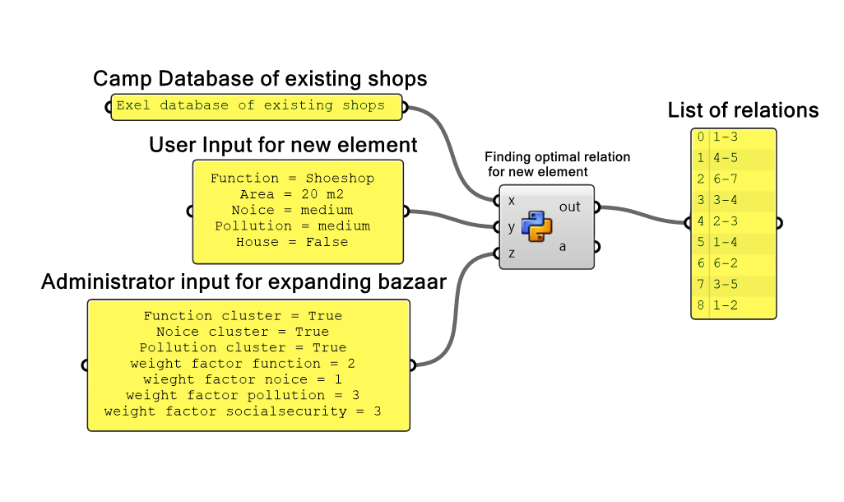
Method - Computational
1. Optimal Relation Database

Slide 20
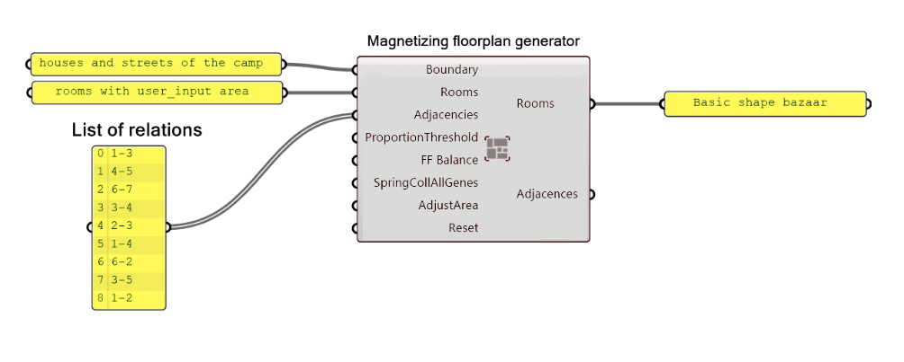
Method - Computational
2. Generate Basic Floorplan

Slide 21
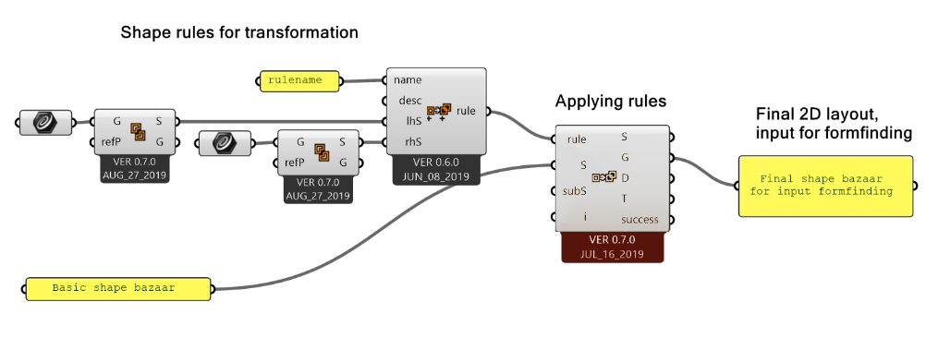
Method - Computational
3. Transforming basic floorplan into formfinding basis

Slide 22
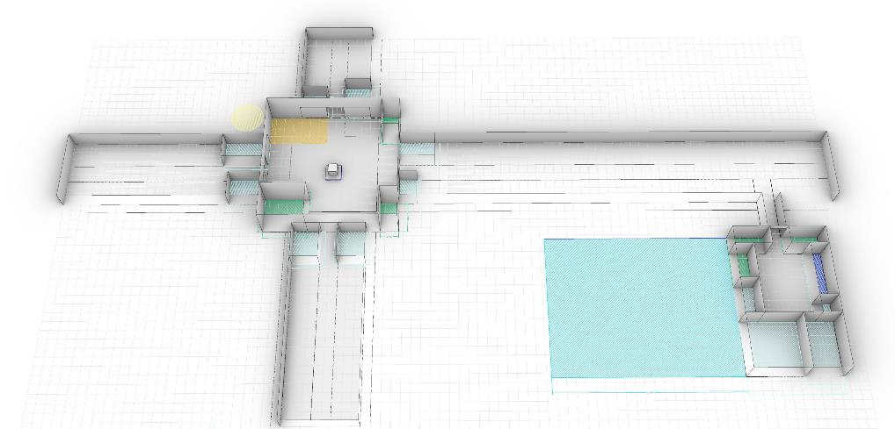
3D configuration
Grid 1.2m

Slide 23
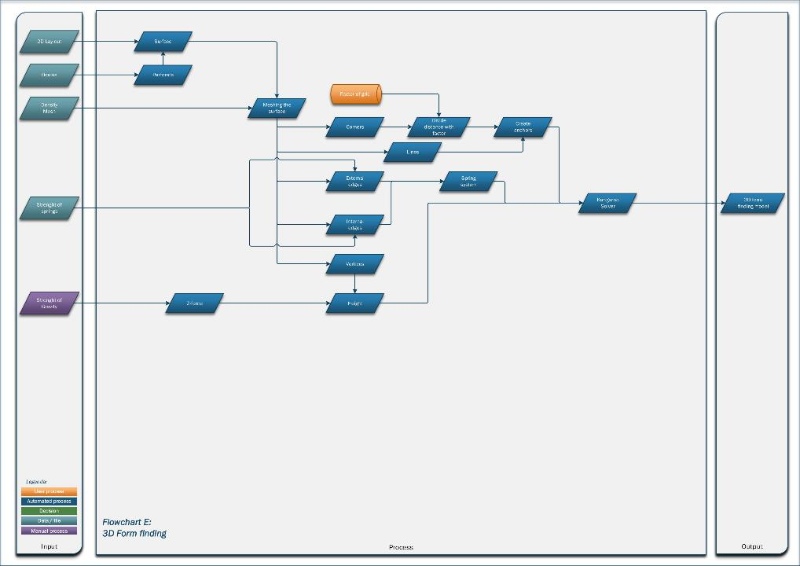
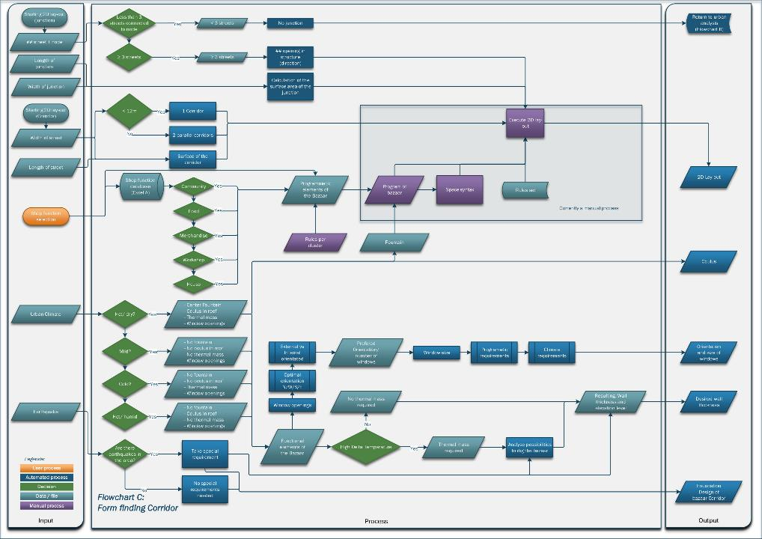
Corridor / Junction Flowchart

Slide 24
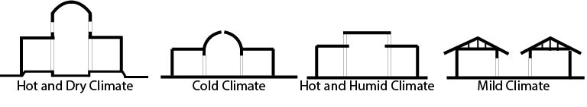
Type of Bazaar
Zataari Camp

Slide 25
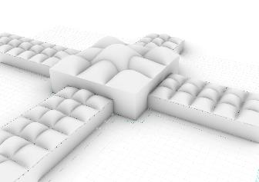
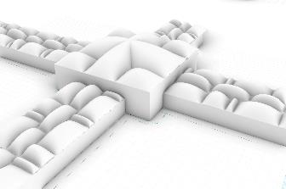
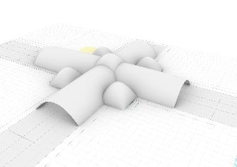



Tessellation/ Relaxation
Modular Roof, Grid 3.6 by 3.6
Overlap
Random
One Vault
Modular Roof, Grid 2.4 by 2.4
Modular Roof, Grid 3.6 by 3.6
Three Vaults

Slide 26



Tessellation/ Relaxation – First found Problems

Slide 27

Pseudocode

Slide 28

Pseudocode

Slide 29

Pseudocode

Slide 30

Plan Forward
Making 2D layout process computational

Slide 31
Plan Forward
Improve form finding
Structural analyses
How to construct

Slide 32

Thank You

Slide 34
Rules Bubble Diagram/ Plan:
-Food shops and Merchandise stores should be placed in the walkway street Community shops should be placed around the junction -or square -Workshops should be placed into a square -Shops which produce a lot of noise should not be next to shops that don’t generate a lot of noise -Shops which produce a lot of noise should not be next to community shops -Every spot in the bazaar should be visible from a house (bazaar can stay open 24/7) -If a new shop owner would like a house, there should be space for it -When the streets have a minimum width of 24m a second street is created -The -seating’s should be connected to – and facing a street, junction or square -A Community area should have public seating to rest and communicate -Seatings should be designed for temporary seating (no sleeping place) -A walkway street is 2.4m in width -A walkway street is connected to the walkway junction and/or walkway square -A shop owner should take care of the walkway in front of his street -Similar functions should be clustered together -The -Exhibition space should be connected to – and facing a street, junction or square -Every shop in the street should have a backstreet -A backstreet should have a width of 1.2m -The street (12m width) includes the walkway, exhibition spaces, shops and backstreets -In the square are seating’s for community shops nearby, workshops and community stores don’t have their own seatings -A square should not be in a main street. -Functions that produce pollution (dust, air pollution) should preferably not be connected to consumables.

Slide 35

Digging VS not Digging in

Slide 36

1.5m VS 3m

Slide 37

Backstreet VS No Backstreet

Slide 38



Betweenness Flowchart

Slide 39

Urban Flowchart

Slide 40

Space Syntax Flowchart

Slide 41
Form Finding Flowchart

Slide 42

3D configuration

Slide 43

3D configuration

Slide 44

Pseudocode

Slide 45

Pseudocode

